Slide 1
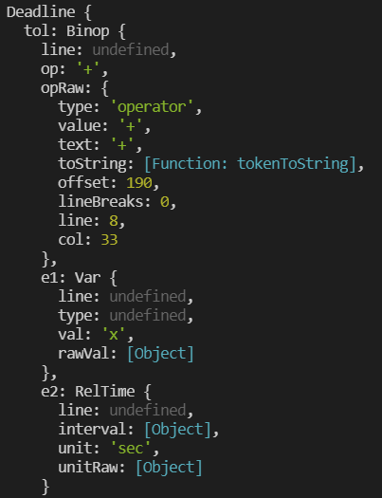
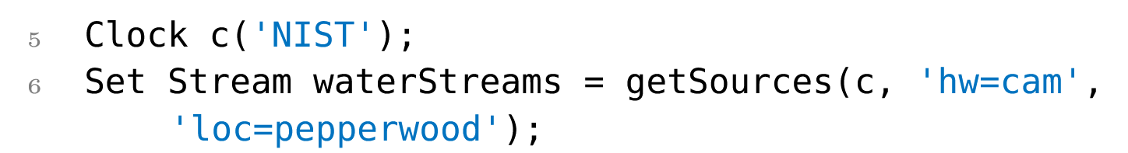
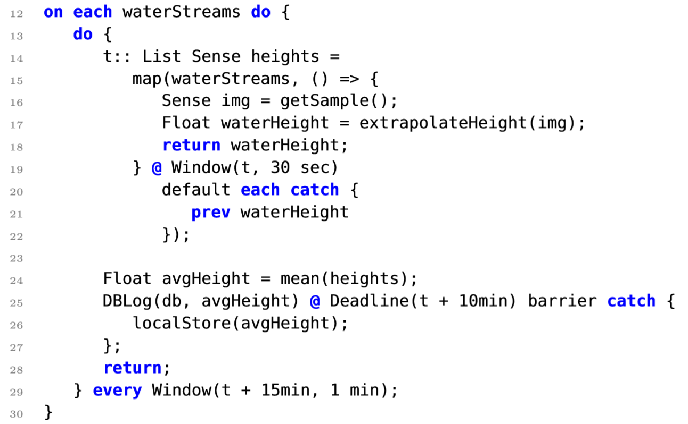

RESEARCH MOTIVATIONS
Gnomad:
A PL to make Programming Timed Sensor Networks Easier
METHODOLOGY
IoT devices should operate within proper time constraints to function effectively.
The code must be distributed in pieces to different devices with different functions.
IoT networks can detect potentially life-threatening changes in the environment, like rising water for example.
The dataflow programming language Gnomad was designed to ensure timely, synchronized, and effective execution.
An Abstract Syntax Tree (AST) was used to organize pieces of data stored in nodes.
Recursive functions were created to traverse the AST by breaking it into simpler pieces found deeper in the branches.
I created an EC object to extract tree data by converting units and interpreting expressions for time.
Matthew Makila, Jonathan Aldrich, Kyle Liang
INTRODUCTION
Internet of Things devices are small inexpensive sensing tools placed in the environment to interact with it and collect data. They can work in tandem to manipulate data over large networks, where timing, communication, and power consumption are key.
The Gnomad PL has implemented timing constructs known as event comparisons to achieve timely actuation in IoT devices.
RESULTS
I helped design event comparisons (ECs), which denote when and in what frequency an event should occur.
ECs are structures from the data tree known as Deadlines and Windows that provide timing information to the compiler.
I designed an object to extract the information from these ECs and funnel it into the compiler to help events occur in a timely fashion.
The AST for a deadline object from parsed text. The deadline contains binary operations and variables that store valuable timing information.
This window specifies an action is repeated every 15 minutes with a 1-minute offset
This sample Gnomad program highlights the use of windows
and deadlines in measuring changes in the stream height to
monitor flooding.
This line features a deadline that specifies an action must be completed within 10 minutes

